Slide 1

Financial Aid Information for
New Jersey High School Students and Families
2027-28 Academic Year
Presented by Jane O’Brien, Associate Director at The College of New Jersey

Slide 2
The Mission
Since 1959, the Higher Education Student Assistance Authority (HESAA) is the only State agency with the sole mission of providing students and families with the financial and informational resources to pursue their education beyond high school.
Higher Education Student Assistance Authority
2
Notes:
HESAA Information Detailed:
Financial aid session
FAFSA Days
Booklets: State and Federal Aid, Financial Aid Dictionary, Student Loan Guide, and Reach Higher the College Planning Booklet.
Handouts: Eight Steps to Apply, Financial Planning Chart, and program brochures are available for free.
REAL $ 101 Financial Literacy on-site Sessions

Slide 3
Agenda
Sources and Types of Aid
How to Apply
How Need is Determined
Award Notifications
Other Useful Information

Slide 4
Net Price Calculator
All institutions must have a net price calculator posted on their websites.
Students will be able to estimate the individual net price per institution.
Based on full-time, first degree/certificate-seeking undergraduate students.
Higher Education Student Assistance Authority
Notes:
HESAA also has on the website the NJEI calculator that calculates TAG for estimate purposes only.

Slide 5
Sources and Types of Aid

Slide 6
Sources & Types of Aid
Factors that may influence institutional aid, particularly merit-based aid
Academics
Athletic Ability
SAT or ACT
Geographic Diversity
AP Courses
Legacy (child of alumni)
Activities
Talent (extracurricular or academic)
Gender/Ethnicity
H.S. Attended
Class Rank
Sources of Aid
The College/University (school-funded aid)
Federal
State of New Jersey
Private Scholarships from civic organizations (ex. local Rotary Club), parent’s employer, high school awards, etc.
Types of Financial Aid
Grants
Scholarships
Loans
Work Study
Higher Education Student Assistance Authority
Notes:
Civic organizations

Slide 7
Types of Aid - Federal
Grants
Federal Student Aid for Award Year 2026-27
  Pell $7,395 (max award)
  SEOG $4,000 (max award)
  TEACH $3,772 (max award)
. * 2027-28 award amounts typically released early 2027
Higher Education Student Assistance Authority
Notes:
Speaker Notes
PELL- SEOG
Named after senator Pell of Rhode Island, Pell is covered under the Higher Education Act of 1965
Pell is need based and all those with an EFC low enough are eligible so long as he or she has not received a first bachelor’s degree yet or are enrolled in a post baccalaureate program that leads to a teacher’s certification or licensure
Currently, the maximum amount is $5,920 and for 17 - 18. The amount of the award will depend on financial need, cost of attendance, and full time or part time status
The limit on Pell is 12 semesters in duration (roughly 6 years)
SEOG can range from $100 to $4000 – funding is provided by the US Department of Education to institutions to manage. Goes to most needy first and are very limited.
The TEACH Grant As a condition for receiving a TEACH Grant, you must sign a TEACH Grant Agreement to Serve in which you agree to (among other requirements) teach
in a high-need field
at an elementary school, secondary school, or educational service agency that serves students from low-income families
for at least four complete academic years within eight years after completing (or ceasing enrollment in) the course of study for which you received the grant.
Iraq and Afghanistan Service Grants
The Iraq and Afghanistan Service Grant is provided to certain students whose parent or guardian was a member of the U.S. armed forces and died as a result of military service performed in Iraq or Afghanistan after the events of 9/11. May not be eligible for a federal PELL Grant but must meet remaining eligibility requirements.
Max award for 17-18 after 10.1.17 is $5,529.28
https://studentaid.ed.gov/sa/about/announcements/sequestration#iraq-afghanistan

Slide 8
New Jersey State Grants 2026-27Academic Year (2027-2028 award amounts to be determined July 2027)
Award Type | Award Amounts
Full-Time TAG | $1,280 - $14,404
Part-Time TAG (community college only) | $320-$1,097
EOF (Educational Opportunity Fund) | Up to $3,050 includes college success support
NJ STARS (top 15.0% of high school class junior or senior year) | Tuition Only - community college only
NJ STARS II | Up to $2,500 per year – any NJ 4-year college
Governor’s Urban Scholarship (for top 5.0% of high school junior year) | Up to $1,000 $500 Persistency Bonus
NJ-GIVS (women and minorities) | Up to $2,000 - building trades only
Community College Opportunity Grant (CCOG) | Up to full tuition and approved fees --AGI between $0 and $65,000
Garden State Guarantee (GSG) | Up to full tuition and approved fees --AGI between $0 and $65,000
Summer TAG | Up to 75% of the Fall or Spring TAG amount
 | 2027-28 award amounts subject to change
2026-27 Award Amounts
Higher Education Student Assistance Authority

Slide 9

State Grants & Scholarship Requirements
Tuition Aid Grant (TAG)
Student’s application must be complete to receive TAG (Tuition Aid Grant) or any other state aid. Students must:
File a FAFSA or New Jersey Alternative Financial Aid Application
Be a U.S. citizen, eligible non-citizen, or qualify as an NJ Dreamer
Be a New Jersey resident and attend a New Jersey institution
Be enrolled full-time* in an approved degree program
Demonstrate financial need
Meet all state deadlines for application and document submission
At TCNJ, TAG awards range from $2,854 - $10,562 (current year)
*Part-Time TAG, NJSTARS, CCOG, and EOF awards are available for county college students enrolled in 6-11 credits per semester.
Notes:
EOF (excellent program for financially and economically disadvantaged students)
EOF supports a wide array of campus-based outreach and support services to help program participants succeed and graduate
Benefits
Students enrolled in an EOF program receive financial assistance through semester grants ranging from $299 to $1,024. Family must have a documented history of financial and economic disadvantage - Some schools require that you are a first generation college student.
The amount of the grant varies depending upon financial need, cost of attendance and available funding.
Awards are renewable annually based on continued eligibility.
Tuition Equity Law: DACA & Undocumented students - Complete the NJ Alternative Application if you are not a United States citizen or eligible noncitizen and meet all of the following criteria;
Attended a New Jersey high school for at least three (3) years
Graduated from a New Jersey high school or received the equivalent of a high school diploma in New Jersey
Registered for Selective Service (male students only)
Are able to file an affidavit stating that you will file an application to legalize your immigration status or will file an application as soon you are eligible to do so

Slide 10
EOF (Educational Opportunity Fund)
Award ranges from $200 - $3,050 annually depending on institution
EOF is campus-based and award amounts vary
Must demonstrate educational and economically disadvantaged background
Complete all required EOF tasks with campus EOF Office
Types of Aid:
State Grants & Scholarships
Higher Education Student Assistance Authority
Notes:
EOF (excellent program for financially and economically disadvantaged students)
EOF supports a wide array of campus-based outreach and support services to help program participants succeed and graduate
Benefits
Students enrolled in an EOF program receive financial assistance through semester grants ranging from $299 to $1,024. Family must have a documented history of financial and economic disadvantage - Some schools require that you are a first generation college student.
The amount of the grant varies depending upon financial need, cost of attendance and available funding.
Awards are renewable annually based on continued eligibility.
Tuition Equity Law: DACA & Undocumented students - Complete the NJ Alternative Application if you are not a United States citizen or eligible noncitizen and meet all of the following criteria;
Attended a New Jersey high school for at least three (3) years
Graduated from a New Jersey high school or received the equivalent of a high school diploma in New Jersey
Registered for Selective Service (male students only)
Are able to file an affidavit stating that you will file an application to legalize your immigration status or will file an application as soon you are eligible to do so

Slide 11
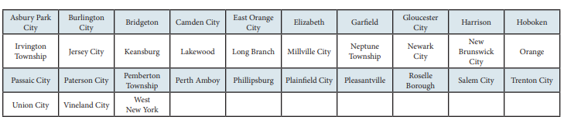
Types of Aid:
State Grants & Scholarships
Governor’s Urban Scholarship
    Rank within the top 5.0% of their class at the end of junior year
    Attain a 3.0 GPA at the end of the junior year
    Reside in a designated municipality
    Qualify for a TAG award
    Annual award amount is $1000
Higher Education Student Assistance Authority
Notes:
EOF (excellent program for financially and economically disadvantaged students)
EOF supports a wide array of campus-based outreach and support services to help program participants succeed and graduate
Must graduate from a traditional public, public charter, county vo-tech or nonpublic school and reside in any of the following townships
GUS - $1,000 annual award – top 5% of HS graduating class
Asbury Park City
Camden City
East Orange City
Irvington Township
Jersey City
Lakewood Township
Millville City
Newark City
New Brunswick City
Paterson City
Plainfield City
Roselle Borough
Trenton City
Vineland City

Slide 12
Types of Aid:
State Grants & Scholarships
  NJ STARS
    NJ residents who rank in the top 15.0% of their class at either the end of junior or senior year of high school
    Students must attain a cumulative GPA of 3.0 or higher at the start of the third semester at the county college to remain eligible for NJ STARS
    Award amount is amount of tuition @ Community College
  NJ STARS II
    Must have been NJ STARS eligible and have a family taxable income of less than $250,000
    Must earn an associate degree and graduate with a 3.25 GPA or higher
    May receive up to $2,500 annually for a TAG-eligible public or private 4-year NJ college or university
Higher Education Student Assistance Authority
Notes:
Governor Christie signed Public Law 2012, Chapter 8 (PL 2012, c.8) into law on May 2, 2012 amending the NJ STARS and NJ STARS II Programs to make them more sustainable.
Limits the amount of the NJ STARS scholarship to tuition only. Budgetary footnote language has limited NJ STARS awards to tuition only since fall 2010 for new program participants.
Eligibility requirements are unchanged.
Must graduate in the top 15.0% of their high school graduating class.
NJ STARS-eligible students must file a FAFSA and complete the State grant record within established State deadlines.
Students may be eligible to receive NJ STARS awards for up to five semesters. Funds are not available to cover summer payments.
NJ STARS-eligible high school graduates may receive awards based on tuition only, after deducting any other federal and/or State grants and scholarships.
Students must attain a minimum cumulative grade point average (GPA) of 3.0 or higher at the start of the third semester of county college enrollment to remain eligible for NJ STARS. Summer courses are included in determining the cumulative GPA.
Students must maintain continuous full-time enrollment unless on a medical leave that is approved by the county college prior to the completion of the semester for which the leave is being granted.
NJSTARS II
Eligibility Requirements as follows:
Earn an associate degree from their home New Jersey county college as an NJ STARS recipient. Must graduate with a cumulative GPA of 3.25 or higher.
Family income (taxable and untaxed income) must be less than $250,000 as derived by the FAFSA
Meet all other program eligibility requirements, including admission into a baccalaureate program at a New Jersey four-year public or private college or university that participates in the TAG program
Complete a FAFSA and the State grant record within established State deadlines
NJ STARS II benefits for non-renewal students were changed by Bill PL 2012, c.8
Non-renewal NJ STARS II students may receive up to $1,250 per semester, paid completely by the State, after all other sources of federal and State grants and scholarships are applied to tuition charges.
Open to all four-year TAG-participating institutions-public or private

Slide 13
Types of Aid:
State Grants & Scholarships
  Governor’s Industry Vocations Scholarship (NJ-GIVS)
    Up to $2,000 per year for the cost of enrollment at one of New Jersey’s 18 county colleges, technical /vocational schools, some proprietary schools
    Benefits women and minorities pursuing certificate or degree programs in construction-related fields
    Must be a NJ resident and have an AGI < $60,000
    Complete separate application online. Found in the student's NJFAMS account, Apply for Scholarships
    Some of the programs eligible for the scholarship include
      Construction Supervision
      Solar Energy Technology
      Architectural Engineering Technology
Higher Education Student Assistance Authority
Notes:
Complete an NJ – GIVS application at njgrants.org
Eligible certificate or degree program

Slide 14

Types of Aid:
State Grants & Scholarships
  The Community College Opportunity Grant (CCOG) pays for the remaining cost of tuition and approved fees at a NJ county college after all other financial aid is applied.
  To be eligible, students must:
  Have a family adjusted gross income (AGI) between $0 and $65,000
  Complete a financial aid application (FAFSA or NJ Alternative Financial Aid Application) each year
  Be pursuing their first associate degree at a NJ community college
  Take a minimum of six credits per semester
  Make satisfactory academic progress throughout participation in the program.
Notes:
Complete an NJ – GIVS application at njgrants.org
Eligible certificate or degree program

Slide 15

Types of Aid:
State Grants & Scholarships
  The Garden State Guarantee (GSG) pays for the remaining cost of tuition and approved fees at a four-year, public institution of higher education in New Jersey during a student’s third (60-89 credits) and fourth (90-128 credits) years of study after all other financial aid is applied.
  To be eligible, students must:
  Have a family adjusted gross income (AGI) between $0 and $65,000
  Complete a financial aid application (FAFSA or NJ Alternative Financial Aid Application) each year
  Be pursuing their first bachelor’s degree at a New Jersey public, four-year college or university
  Take a minimum of 12 credits per semester
  Make satisfactory academic progress throughout participation in the program.
Higher Education Student Assistance Authority
Notes:
Complete an NJ – GIVS application at njgrants.org
Eligible certificate or degree program

Slide 16
Loans
Federal Direct Loan Program (1st year dependent student)
  Subsidized Loan $3,500 need based
  Unsubsidized Loan $2,000 additional
2026-27- Federal Undergraduate Direct Loan interest rates
are 6.52%, plus a 1.057% origination fee
Annual loan amount increases as student progresses:
  Sophomores $4500 sub and $2000 unsub
  Juniors/Seniors $5500 sub and $2000 unsub
2027-28 federal interest rates and fees change annually typically July 1, 2027
Higher Education Student Assistance Authority
Notes:
Graduate Stafford loans are now 6%

Slide 17
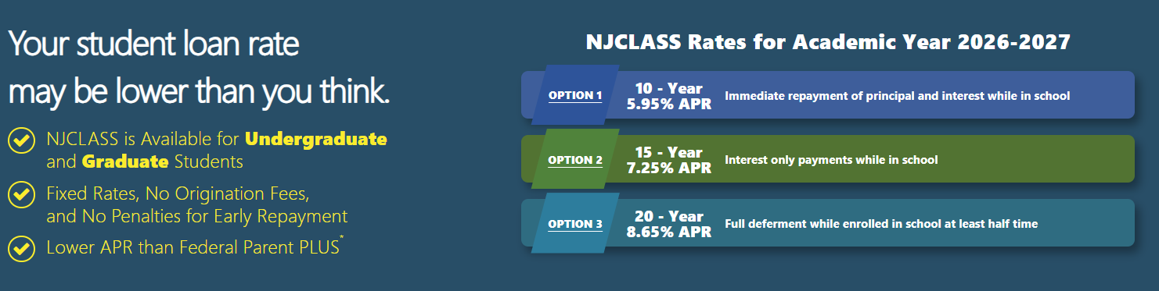
Option: 2026-27 Federal Parent PLUS loan
Interest rate of 9.07%
Capped at $20,000 annually per student
Educational Loan Options
Borrow up to Cost of Attendance less other aid
Option: State of NJ – NJCLASS
Can be used at colleges in or out of state
Option: 2026-27 Private Bank (various lenders)
Interest rate average of 11.20%
*
2027-28 interest rates will be determined in June 2027
Notes:
We also offer consolidation programs & a ReFi program that
Consolidation extends the repayment term to 25 – 30 depending on loan balance and takes the weighted average of the loans minus a tiny percentage
The ReFi program is a 10 year repayment term and is based on income, credit score and debt to income ratio (depending on credit score the APR will range from 4.90% to 6.90%
HESAA also now has a Repayment Assistance Program (RAP), which is designed to provide payment relief when all parties of the loan are facing financial hardship
During the RAP period, a payment on eligible NJCLASS loan shall be reduced to 10% fo the total of the household income of all of the parties to the loan that exceeds 150& of the federal poverty guidelines for their family size, with a minimum monthly payment of $5 per eligible loan
Interest that accrues during RAP will be paid by HESAA
RAP is available for NJCLASS loans with applications that were received on or after June 1, 2017 or are to be used for an academic term that begins on or after August 1, 2017
HESAA now also discharges the loan obligation for all parties to a NJCLASS loan in the event of death or total and permanent disability of the student beneficiary

Slide 18
Applications

Slide 19
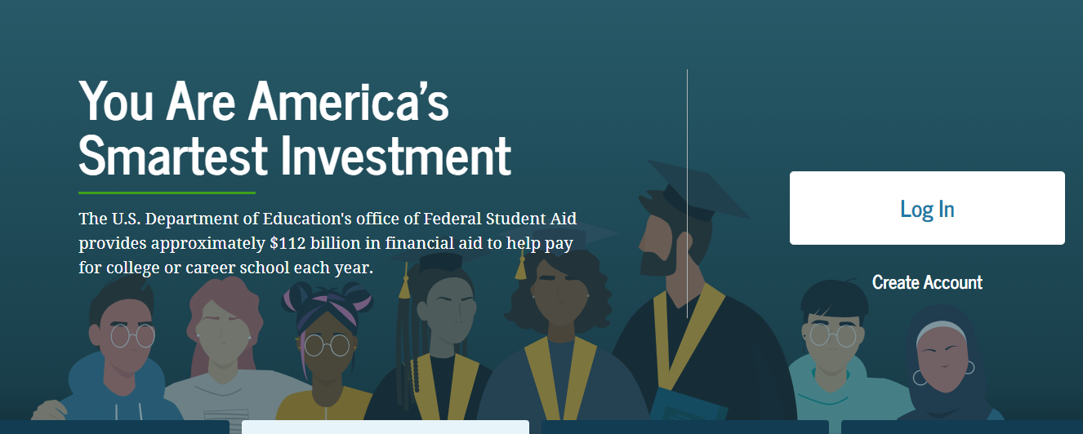


Applications to Access Aid
studentaid.gov
FAFSA
Available October 1, 2026
student.collegeboard.org/profile
CSS Profile
Available October 1, 2026
HESAA.org
NJ Dreamer
Available by October 1, 2026
Higher Education Student Assistance Authority
Notes:
Jules / Sharon – please add screen shot for alt app

Slide 20
Application: CSS Profile
Approximately 400 colleges and organizations use the CSS profile to determine how they will award institutional (school-funded) aid
Available October 1 each year and collects more comprehensive income, asset, and household information than the FAFSA
Uses 2025 & 2026 income for 2027-28
Mostly used by independent (private) colleges and universities
Register – Complete Application – Make payment – Submit
No application fee for income under $100,000
All others, $25 for first application and $16 for each additional
Higher Education Student Assistance Authority
Notes:
Check out http://student.collegeboard.org/profile for a list of institutions that require CSS profile
CSS profile uses institutional methodology formula whereas FAFSA uses federal methodology
The CSS profile is a fee based application. The cost for filing the CSS PROFILE is $25 for the first college, and there is an $16 processing fee for each additional college. This is not the FAFSA. The FAFSA is free.
Can take 45 minutes to 2 hours to complete
Can leave some answers blank but an error will prompt if answer is required but most numeric questions at least require a zero

Slide 21

CSS Profile
Website to apply for profile
https://cssprofile.collegeboard.org/
Website to apply for Noncustodial Profile:
https://cssprofile.collegeboard.org/profile-for-parents
Participating CSS Institutions:
https://profile.collegeboard.org/PPI/participatingInstitutions.aspx
Customer Support - 844-202-0524 | Live Chat Available
Higher Education Student Assistance Authority
20
Notes:
Links are correct

Slide 22
The 2027-28 FAFSA is available by October 1, 2026
Collects family’s personal and financial information used to calculate the student’s Student Aid Index (SAI). The SAI determines eligibility for federal student aid
File the FAFSA electronically online at www.studentaid.gov
FAFSA uses prior-prior year income information (2025 for award year 2027-28)
All contributors on the application (student and parent(s) or spouse) must provide consent to the IRS to obtain Federal Tax Information (FTI) to populate income and tax information with actual prior-prior year tax information
  All prior-prior year tax information (2025) is already filed, allowing immediate retrieval.
Free Application for Federal
Student Aid (FAFSA)
Higher Education Student Assistance Authority
Notes:
You should use the IRS DRT at the time of filing the initial FAFSA. Using this tool will automatically verify your information for federal

Slide 23
Used to provide consent to obtain Federal Tax Information and digitally sign the FAFSA
Student and all Contributors must create a StudentAid.gov Account (also known as an FSA ID) at www.studentaid.gov by clicking on “create account”
Student identifies who the Contributor(s) are and invites them via email to contribute to the FAFSA with an “Invite Code.” Each contributor must have their own separate StudentAid.gov username and password, and will log in and provide the “Invite Code’ to begin.
Contributors include: Biological Parent, Stepparent, and Adoptive Parent (or a Student’s Spouse, if applicable)
Who Needs a StudentAid.gov Account?
    If there are two parents who filed taxes jointly, only one parent
    If the parents are divorced/separated, the parent who provided more financial support in the last 12 months
    If married or unmarried/living together but did not file taxes jointly, then each parent will need an FSA ID
2027-28
Federal
Student Aid ID
(FSAID)
Higher Education Student Assistance Authority
Notes:
The FSA id is a higher security login which will connect the student and parent to the FAFSA. The FSA id will also connect the student to the federal student aid website, and the National student loan data base.

Slide 24
2027-28 StudentAid.gov Account for Undocumented Contributors
Contributors who do not have an SSN will register with their name, date of birth, permanent address, email address and will have to verify identity through a knowledge-based verification process
All contributors must be verified by individual email when creating their StudentAid.gov Account (FSA ID account)
Contributors who cannot verify identity will be able to complete the process of creating their StudentAid.gov account (FSA ID account) and complete the FAFSA
FSA will send a case number with information to submit documentation to verify identity via email
Higher Education Student Assistance Authority
Notes:
The FSA id is a higher security login which will connect the student and parent to the FAFSA. The FSA id will also connect the student to the federal student aid website, and the National student loan data base.

Slide 25
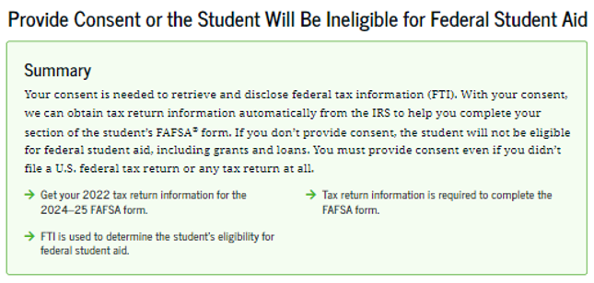
Contributors will be instructed to provide Federal Tax Information from their 2025 tax return to be used to determine the student's eligibility for federal student aid for Award Year 2027-28
Federal Tax Information Consent
2022
Get your 2025 tax return information for the
2027-28 form.
Higher Education Student Assistance Authority
Notes:
This

Slide 26
The student must have a valid Social Security Number
Must be pursuing a degree, certificate, or other recognized postsecondary credential
Must be a U.S. citizen or eligible noncitizen
New Jersey students who are not eligible to file the FAFSA but meet the qualifications for NJ Dreamers should complete the NJ Alternative Financial Aid Application for state-funded financial aid instead
Key Eligibility
Requirements for FAFSA
Higher Education Student Assistance Authority
Notes:
If you are an eligible noncitizen, write in your eight- or nine-digit Alien Registration Number. Generally, you are an eligible noncitizen if you are (1) a permanent U.S. resident with a Permanent Resident Card (I-551); (2) a conditional permanent resident with a Conditional Green Card (I-551C); (3) the holder of an Arrival-Departure Record (I-94) from the Department of Homeland Security showing any one of the following designations: “Refugee,” “Asylum Granted,” “Parolee” (I-94 confirms that you were paroled for a minimum of one year and status has not expired), T-Visa holder (T-1, T-2, T-3, etc.) or “Cuban-Haitian Entrant;” or (4) the holder of a valid certification or eligibility letter from the Department of Health and Human Services showing a designation of “Victim of human trafficking.”
If you are in the U.S. on an F1 or F2 student visa, a J1 or J2 exchange visitor visa, or a G series visa (pertaining to international organizations), select “No, I am not a citizen or eligible noncitizen.” You will not be eligible for federal student aid. If you have a Social Security Number but are not a citizen or an eligible noncitizen, you should still complete the FAFSA because you may be eligible for state or college aid.
The Selective Service System and the registration requirement for your men, preserves America’s ability to provide manpower in an emergency to the US armed forces Almost all men ages 18 to 25 must register. For more information please visit 222.sss.gov

Slide 27
Key Components of the FAFSA
Student Contributor Section
Full Name and address
Social Security Number or ITIN Number
Date of Birth
Mobile phone number (optional)
Email address
College/Career plans – 20 Colleges
Student Consent and Assets
FTI (Federal Tax Information)
Student Status: Personal Circumstances
Dependent or Independent Determination
Student Special Circumstances
Student Unusual Circumstances
Social Security Number
Parent Contributor Section
Last Name
Date of Birth
Email address
Family size – FTI
Income and Assets
Federal Means-tested benefits
  Medicaid, SSI, SNAP,
  Free or Reduced Lunch
  TANF, WIC, WITC QHP
Business and Farm will be considered as assets in the calculation of the SAI
Child Support received is an asset
Higher Education Student Assistance Authority
Notes:
WHO IS THE PARENT
If your parent was never married and does not live with your other legal parent, or if your parent is widowed or not remarried, answer the questions about that parent.
• If your legal parents (biological and/or adoptive) are not married to each other and live together, select “Unmarried and both parents living together” and provide information about both of them regardless of their gender. Do not include any person who is not married to your parent and who is not a legal or biological parent. Contact 1-800-433-3243 for assistance in completing questions 80-94.
• If your parents are married, select “Married or remarried.” Consistent with the Supreme Court decision holding Section 3 of the Defense of Marriage Act (DOMA) unconstitutional, same-sex couples must report their marital status as married if they were legally married in a state or other jurisdiction (foreign country) that permits same-sex marriage, without regard to where the couple resides. If your legal parents are divorced but living together, select “Unmarried and both parents living together.” If your legal parents are separated but living together, select “Married or remarried,” not “Divorced or separated.”
• If your parents are divorced or separated, answer the questions about the parent you lived with more during the past 12 months. (If you did not live with one parent more than the other, give answers about the parent who provided more financial support during the past 12 months or during the most recent year that you actually received support from a parent.) If this parent is remarried as of today, answer the questions about that parent and your stepparent.
• If your widowed parent is remarried as of today, answer the questions about that parent and your stepparent.

Slide 28
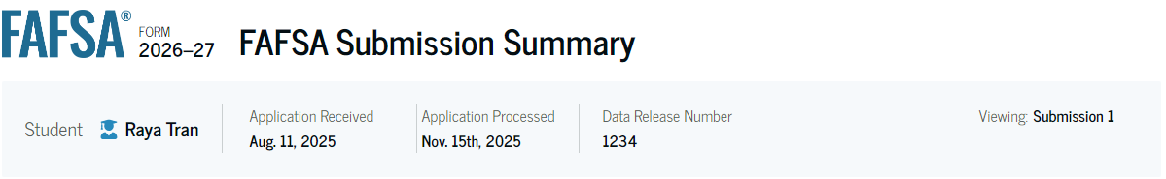
  All Contributors will receive an individual
  FAFSA Submission Summary
FAFSA Submission Summary
  Applicants are instructed to log into “NJFAMS.HESAA.org” to create a user ID and password. In 3-5 business days, students can check their awards and eligibility status and complete any outstanding items on their “To Do” list. (There is no separate State Application, only a To-Do List in the state’s NJFAMS system).
  Please note, all notifications will be sent to the student‘s email address listed on the FAFSA.
Higher Education Student Assistance Authority
Notes:
Should be removed but NJ is still on the list for adtl questions.

Slide 29
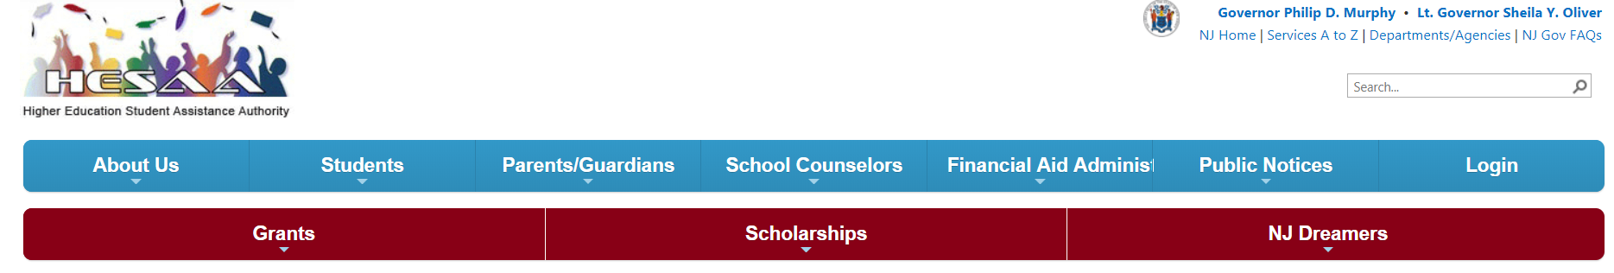
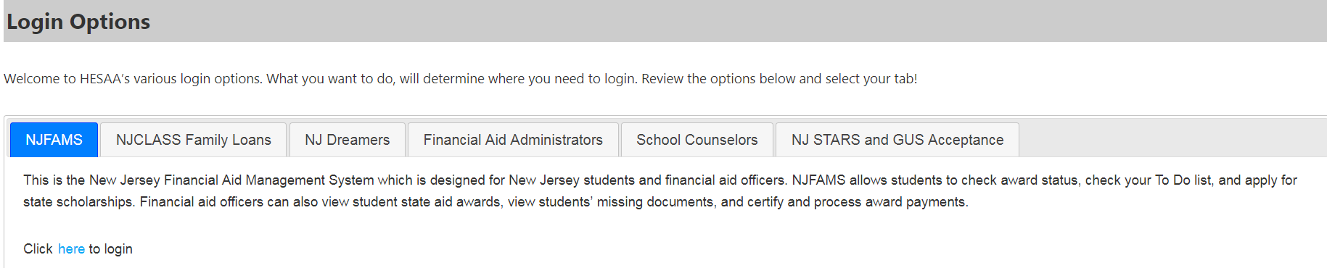
New Jersey
Financial Aid
Management
System - NJFAMS
All students must go to “NJGRANTS.org”
Establish an NJFAMS Account by creating a User ID and Password
Track the status of your State-funded student aid and respond to required tasks on the To-Do List
Higher Education Student Assistance Authority
Notes:
Jules / Sharon – add pic of NJFAMS login slide from NJGRANTS

Slide 30
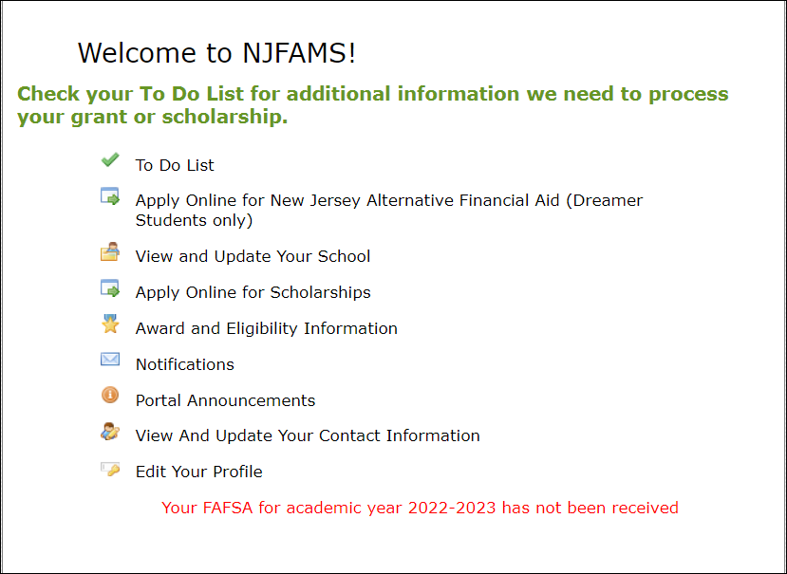
NJFAMS –
Menu
ALL Students must register
Higher Education Student Assistance Authority
Notes:
Jules / Sharon – add pic of NJFAMS login slide from NJGRANTS

Slide 31
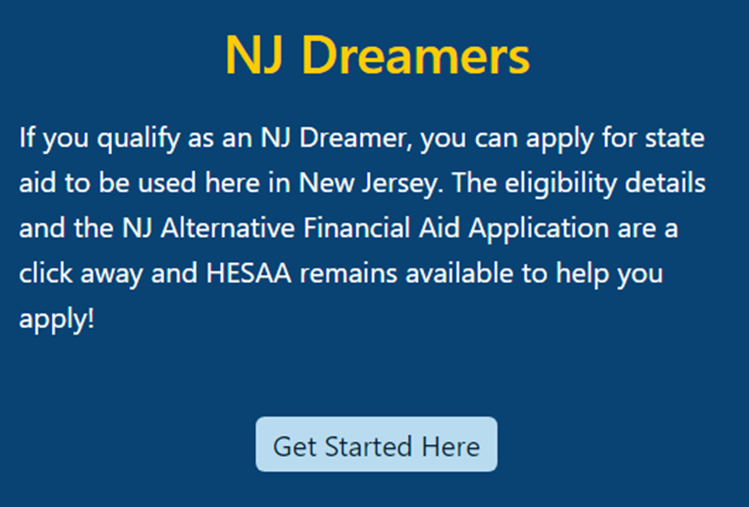

New Jersey Dreamers
Students qualify as an NJ Dreamer if they are not eligible to file the FAFSA but attended an NJ high school for at least 3 years, graduated from an NJ high school (or got an NJ GED), and filed/will file an application to legalize their immigration status as soon as possible.
NJ Dreamers can apply for State Aid by completing the NJ Alternative Financial Aid Application in NJFAMS: https://njfams.hesaa.org
Register for your account by creating a User ID and Password
Login to complete the application by established State deadlines
Must meet all other need and/or merit-based eligibility criteria for State student aid
Higher Education Student Assistance Authority
Notes:
Jules / Sharon – add pic of NJFAMS login slide from NJGRANTS

Slide 32
Federal & State Verification
    School is responsible for verifying information
    for federal aid except for special circumstances
    HESAA is responsible for verifying information for
    State aid
    Schools may send request for information by mail
    or e-mail
    Always check your school financial aid portal and NJFAMS account for required tasks. Note: The college and HESAA do not share documentation
    Be sure to meet verification deadlines
Higher Education Student Assistance Authority

Slide 33
How Need is Determined

Slide 34
Cost of Attendance
Tuition and fees
Food and housing
Books and supplies, equipment, transportation,
and miscellaneous personal expenses
Medical Insurance
Federal Loan Fees
Study abroad costs
Expenses for cooperative education program
Higher Education Student Assistance Authority
Notes:
Unexpected costs
Remediation Classes: extra 1 – 2 semesters
Change in major: 1 – 2 years in addition
Transferring: possible extra semester
Unpaid internships: loss of Summer wages
Study Abroad, Spring break, trips home and
pledging costs
Moving expenses and Summer storage

Slide 35
What Is The Student Aid Index
(SAI)?
SAI is determined by a federal formula that calculates federal Pell Grant eligibility and is used to determine further financial need using the information you supplied on the FAFSA
SAI and Financial Need are guidelines used by
schools to determine student aid offers
Higher Education Student Assistance Authority

Slide 36
Financial Need for Smith Family
College | Community College | State College or University | Private College or University
COA | $8,000 | $30,000 | $60,000
SAI Other Financial Aid | 8,667 | 8,667 | 8,667
Unmet Financial Need | $0 | $21,333 | $51,333
Higher Education Student Assistance Authority
37
Notes:
All examples include approximate tuition, fees (left out new student fee), room and board for academic year.

Slide 37
Award Notifications

Slide 38
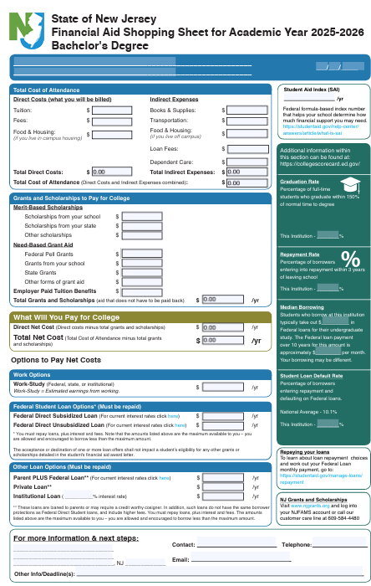
The College Financing Plan
New Jersey Shopping Sheet
Help families with net cost transparency
Separates the Cost of Attendance listing the direct and indirect costs
Grants and Scholarships (no repayment required, “free money”)
Student Net Costs in center box
College coordinated work-study employment
Federal Student Loans
If necessary, alternate loans
Higher Education Student Assistance Authority
Notes:
Deadlines for completing state grant records (tasks, verification, corrections etc…) are on our website as well as deadlines for college code changes, updates, additions and deadlines

Slide 39
Award Notifications
Will vary by institution
May be hard copy and/or viewable in school’s student system
Items to note:
  Has a PLUS Loan been included in awards?
  What are terms of any scholarship offers?
  Will private scholarship effect other scholarship offers?
  Does student need to take any action? (Accept awards? Any deadlines to do do?)

Slide 40
Other Information

Slide 41
The Cycle of Financial Aid
October - March | Complete FAFSA application, college search, college application process, and CSS Profile
February - May | Schools send financial aid offers
June - July | Schools send Fall semester bills
August | Bills are due
Higher Education Student Assistance Authority
Notes:
CSS Profile is essential for some colleges institutional aid.

Slide 42
Where Do I Go From Here?
Obtain and review admission, financial aid materials, and deadlines from each school to which you are applying
Meet all application deadlines:
  CSS Profile if applicable
  Complete the FAFSA and any other application materials required by the school or your state agency
  NJ State deadlines for high school Class of 2027:
    September 15, 2027 for Fall 2027 and Spring 2028 semesters and February 15, 2028 for Spring 2028 ONLY awards
    April 15, 2027 to renew your financial aid for Academic Year 2027-28
Note: After 1st year, students must renew ANNUALLY by April 15th, if the student received a State TAG award in the current year
Higher Education Student Assistance Authority
Notes:
Deadlines for completing state grant records (tasks, verification, corrections etc…) are on our website as well as deadlines for college code changes, updates, additions and deadlines

Slide 43
Other Resources
Outside Scholarships
Campus-Administered Payment Plans
Campus Employment (including school-sponsored “work-study” jobs)
Specialized Campus Opportunities
Residential Advisors (RAs)
Student Ambassadors/Tour Guides
Internships/Co-ops
Higher Education Student Assistance Authority

Slide 44

Private Scholarship Search
Institution/college websites
Local library resources
Local businesses, civic organizations, and churches
  Check with your High School guidance office
Parent’s employer(s)
www.hesaa.org
www.fastweb.com
www.collegeboard.org
www.mappingyourfuture.org
Higher Education Student Assistance Authority

Slide 45
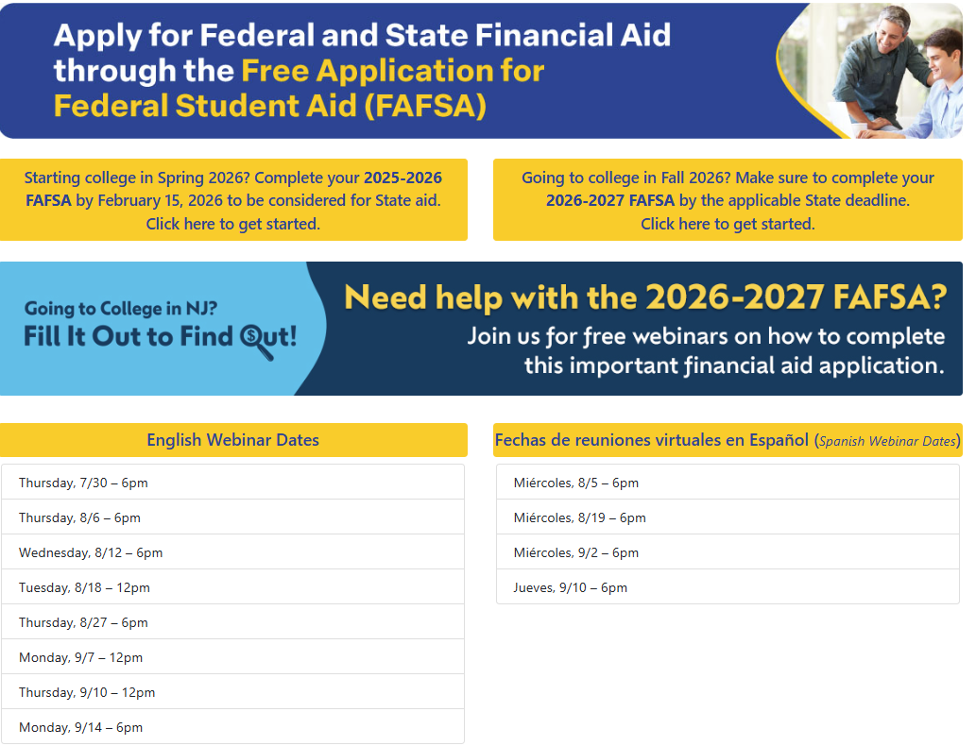
New Jersey Financial Aid Workshops
& Webinars
Live Webinars
NJ Dreamer Schedule - www.hesaa.org/Pages/NJAlternativeApplication.aspx
FAFSA Schedule - www.hesaa.org/Pages/FAFSA.aspx

Slide 46
HESAA Services
Customer Care Center
  Email: Outreach@hesaa.org
  Call Center 609-584-4480 Monday – Friday: 8:30 – 5
Online Resources
  www.hesaa.org
  www.njgrants.org
  www.njclass.org
  https://njfams.hesaa.org
  www.hesaa.org/pages/financialaidhub
Higher Education Student Assistance Authority

Slide 47

QUESTIONS?
Thank you
Higher Education Student Assistance Authority

